Slide 1
Phishing Awareness Training

Slide 2
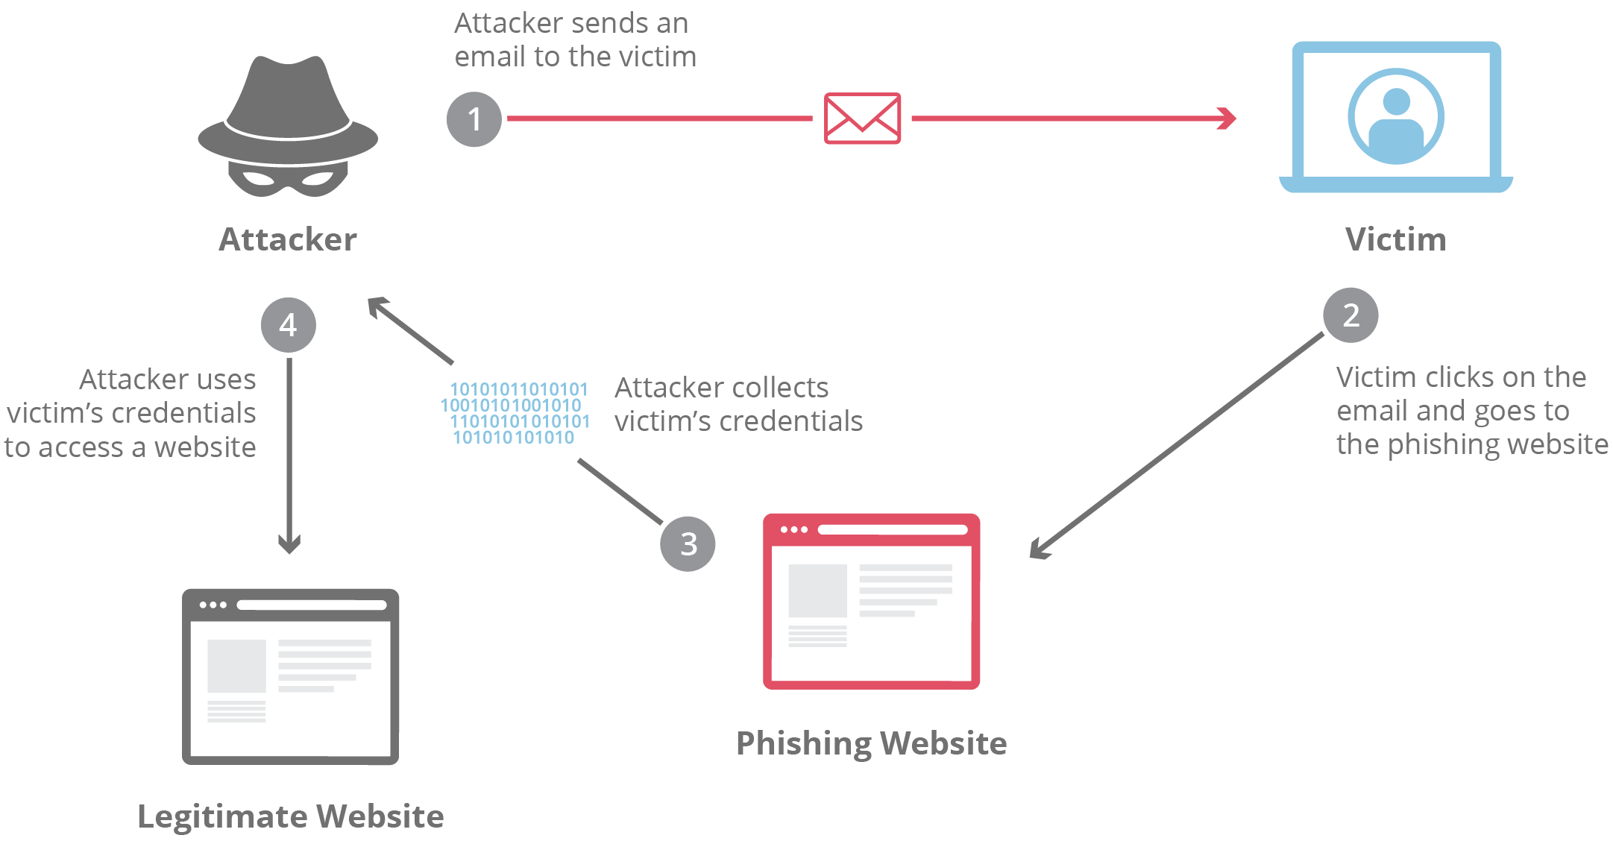
1️⃣ What is Phishing?
Phishing is a cyberattack where attackers impersonate trusted entities (banks, companies, friends) to steal:
Passwords
OTPs
Credit/debit card details
Personal information
📌 Goal: Trick users into clicking malicious links or downloading harmful files.

Slide 3
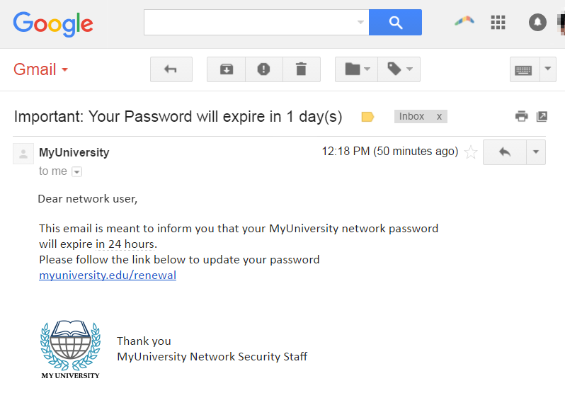
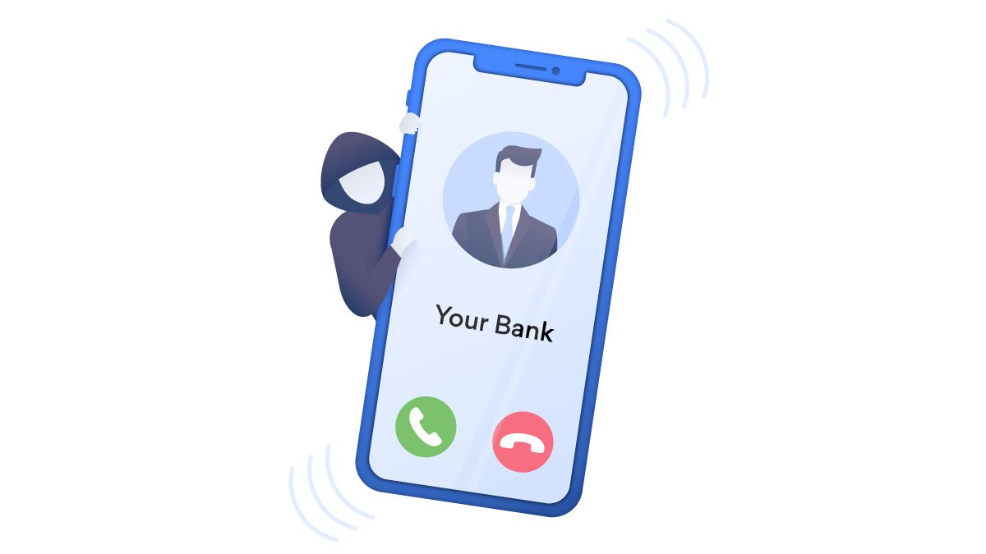
Some basic example of phishing
Email phishing
Evil twin phishing
vishing

Slide 4
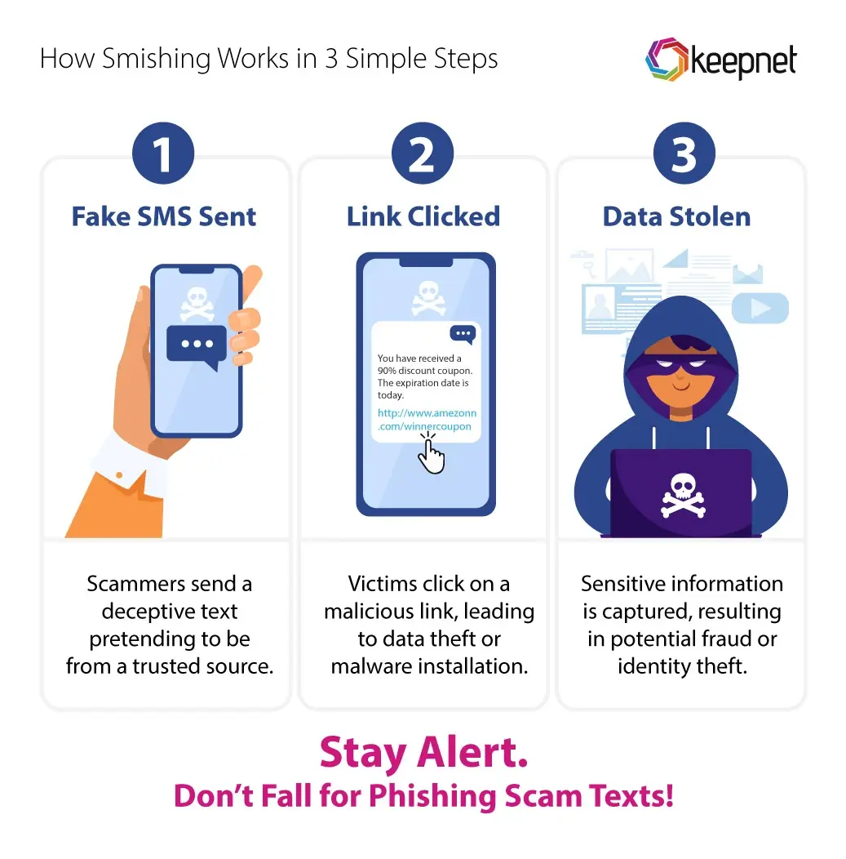
2️⃣Types of phishing
Common Types:
Email Phishing – Fake emails pretending to be legit
Spear Phishing – Targeted attacks on specific individuals
Smishing – Phishing via SMS
Vishing – Phishing via phone calls
Clone Phishing – Copy of a real email with a malicious link

Slide 5
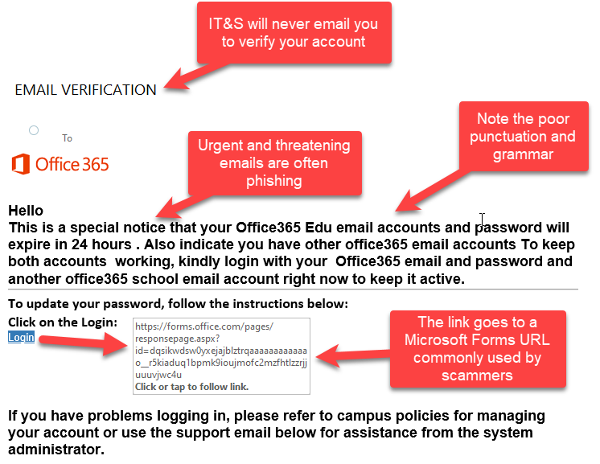
Email phishing
🔹 What it is
Email phishing is the most common phishing attack where attackers send fake emails pretending to be trusted organizations like banks, Google, Amazon, or colleges.
🔹 How it works
Attacker sends a fake email
Email contains a malicious link or attachment
Victim clicks → redirected to fake website
Login details or OTPs are stolen
🔹 Common Signs
Urgent messages like “Verify immediately”
Fake sender addresses
Grammar mistakes
Unexpected attachments
🔹 Example
Fake bank email asking to “update KYC details”.

Slide 6
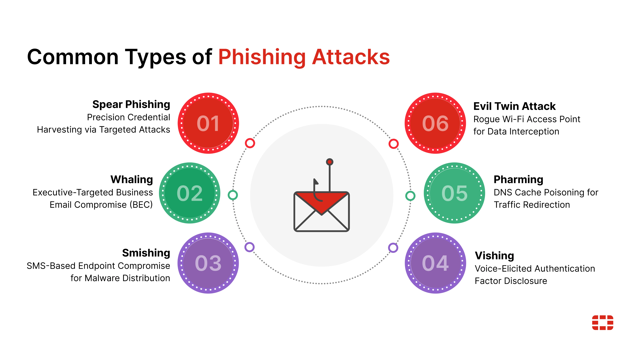
Spear Phishing
🔹 What it is
Spear phishing is a targeted phishing attack aimed at a specific person or organization.
🔹 How it works
Attacker collects personal info (name, role, company)
Crafts a personalized email
Appears very genuine and trustworthy
🔹 Why it’s Dangerous
Harder to detect
Higher success rate
Often used in corporate breaches
🔹 Example
Email sent to an employee pretending to be the company HR asking for salary details.

Slide 7
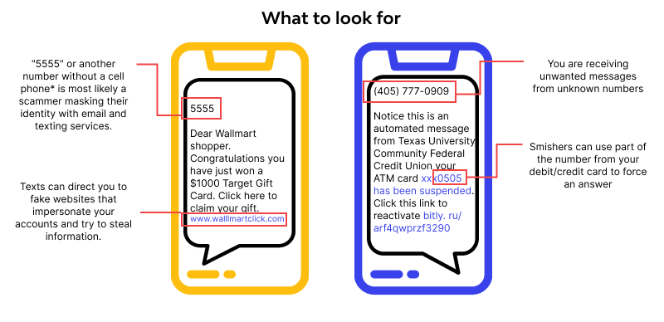
Smishing (SMS Phishing)
🔹 What it is
Smishing is phishing carried out through SMS/text messages.
🔹 How it works
Fake SMS contains a link or phone number
Message creates urgency or curiosity
Clicking link installs malware or steals data
🔹 Common Messages
“Your parcel is pending”
“Your account is blocked”
“Click to claim reward”
🔹 Example
SMS saying “Track your delivery” with a malicious link.

Slide 8
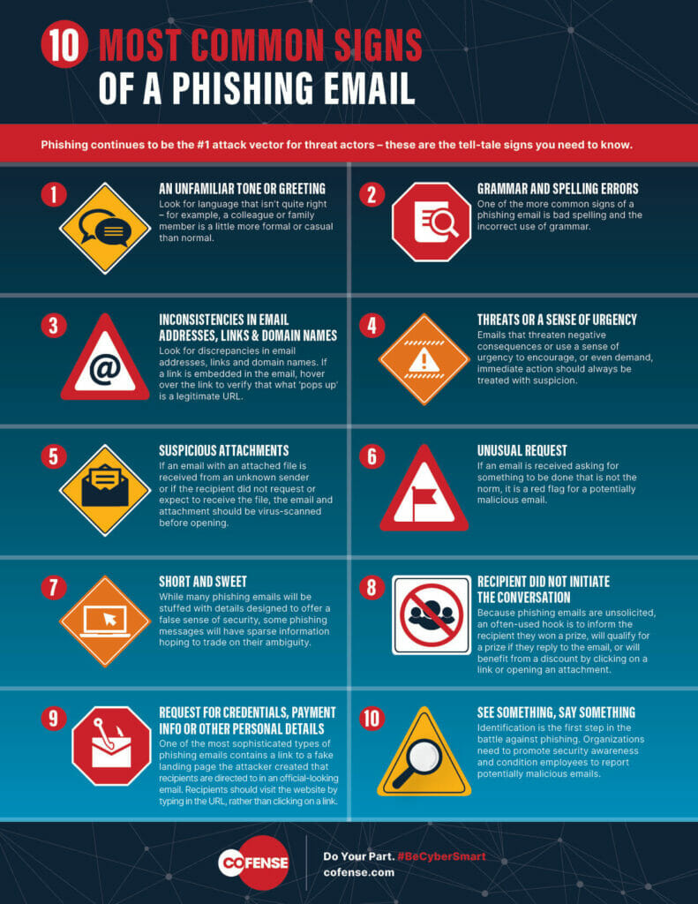
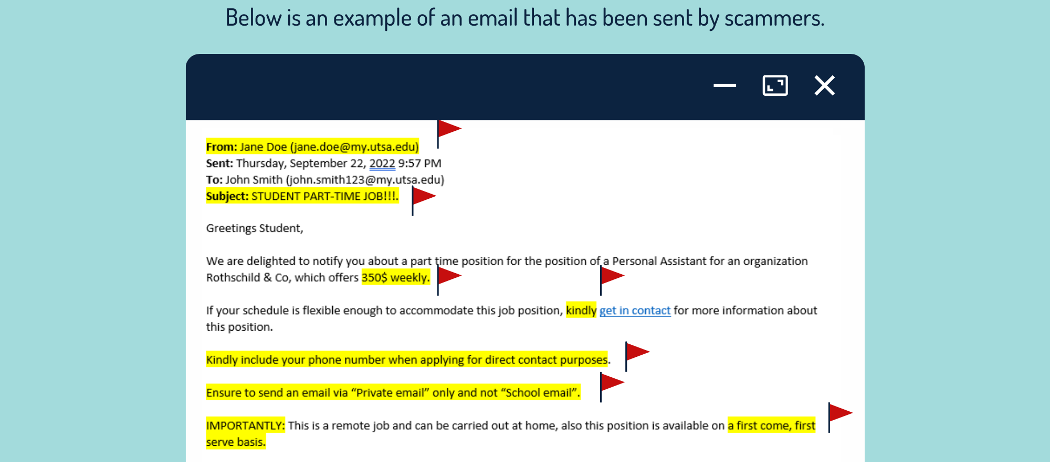
3️⃣How to Recognize Phishing Emails
🚩 Red Flags in Emails:
Urgent language (“Act now!”, “Account will be locked”)
Suspicious sender email (e.g., support@paypa1.com)
Spelling & grammar mistakes
Unexpected attachments or links
Requests for sensitive information
✅ Rule: Legit companies NEVER ask for passwords or OTPs via email.

Slide 9
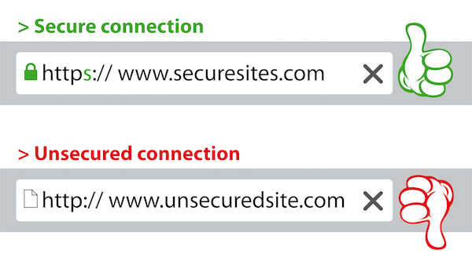
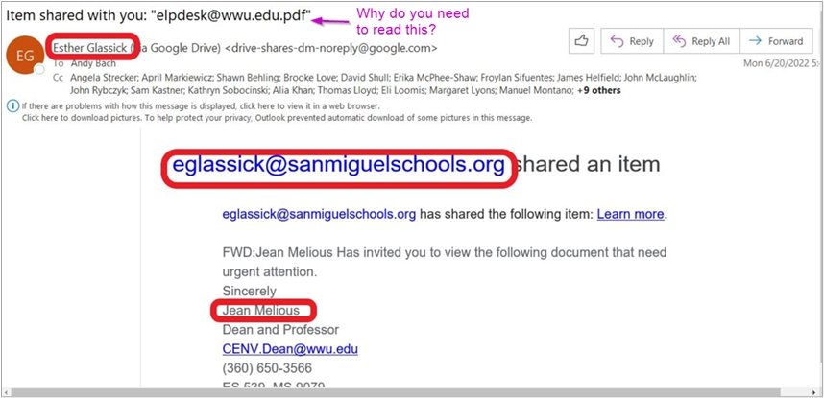
4️⃣ How to Identify Fake Websites
🔍 Check Before You Trust:
URL spelling errors (amaz0n, g00gle)
No HTTPS or broken lock icon
Poor design / fake logos
Login pages asking excessive information
🛑 Always type website URLs manually instead of clicking links.

Slide 10
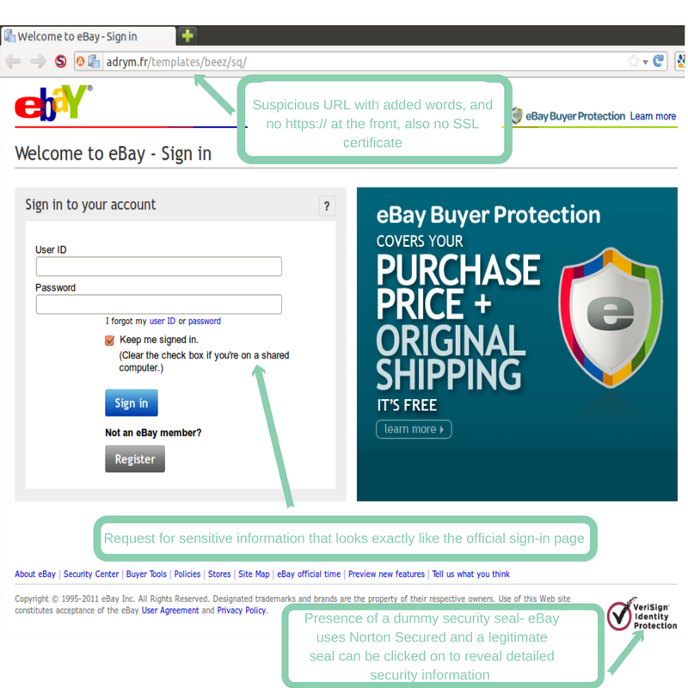

Slide 11
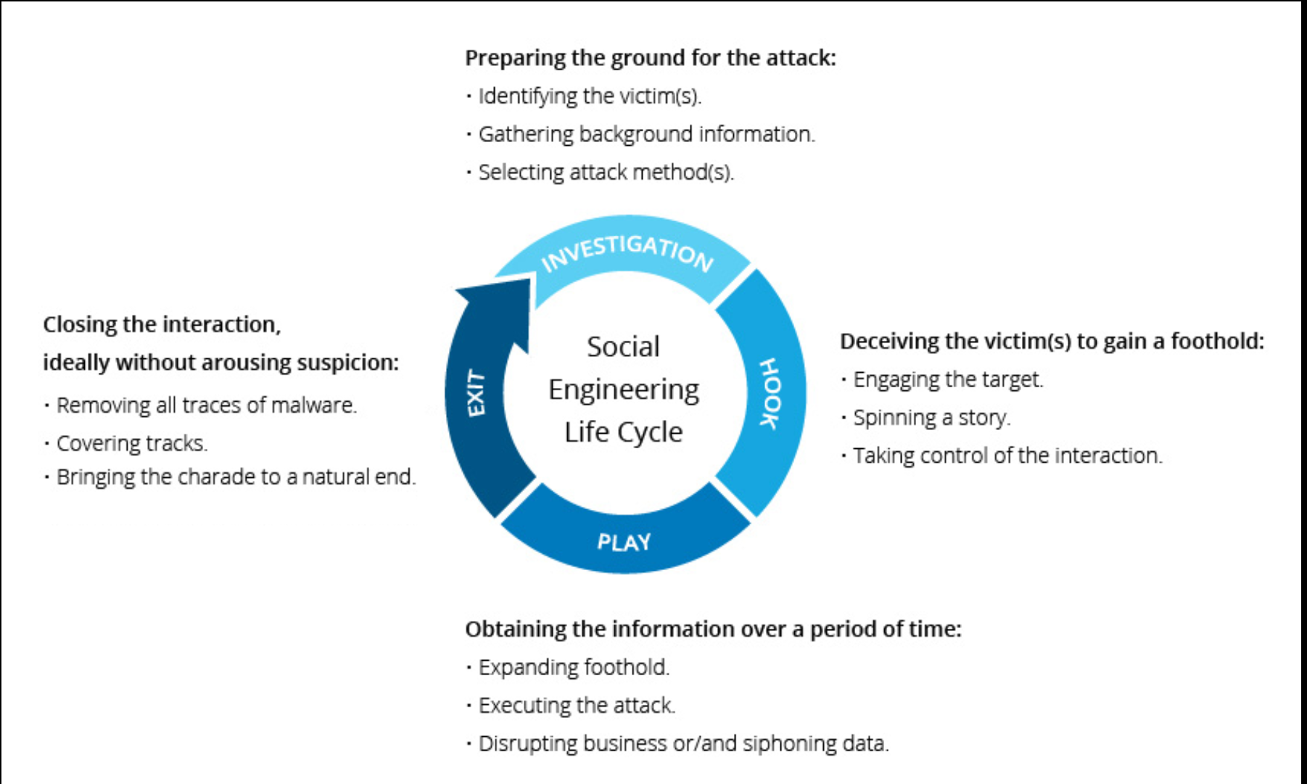
5️⃣ Social Engineering Tactics Used by Attackers
Attackers manipulate human psychology, not systems.
Common Tactics:
>Fear: “Your account is compromised”
>Authority: “This is IT support”
>Urgency: “Respond within 10 minutes”
>Greed: “You won a prize”
>Trust: Pretending to be friends or colleagues

Slide 12
🔐 What is Social Engineering?
Social engineering is a technique where attackers manipulate human behavior and emotions to gain access to confidential information, systems, or money.
➡️ Instead of hacking computers, attackers hack people.
🧠 Major Social Engineering Tactics
1️⃣ Authority-Based Attack
👔 Tactic: Pretending to be someone powerful or trusted.
2️⃣ Fear & Threat Tactic
⚠️ Tactic: Scaring the victim into quick action.
3️⃣ Urgency & Time Pressure
⏱️ Tactic: Creating artificial urgency.
4️⃣ Trust & Familiarity
🤝 Tactic: Impersonating someone the victim trusts.

Slide 13
5️⃣ Greed & Rewards
🎁 Tactic: Luring victims with benefits.
6️⃣ Curiosity Trap
🧩 Tactic: Triggering curiosity.
7️⃣ Sympathy & Help-Seeking
😢 Tactic: Playing the victim.
🧩 Why Social Engineering is Effective
✔ Humans trust more than systems ✔ Emotions override logic ✔ Lack of awareness ✔ Attack looks legitimate
🛡️ How to Defend Against Social Engineering
Think before reacting
Verify identity using official channels
Never share OTP, PIN, or passwords
Be suspicious of urgency
Educate employees & users regularly

Slide 14
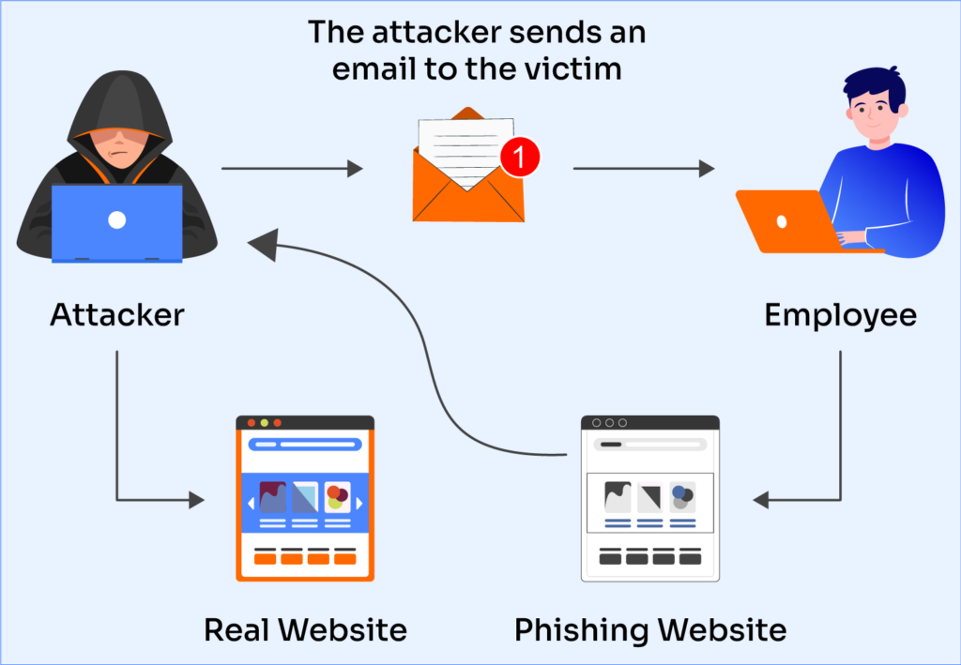
6️⃣ Best Practices to Stay Safe
✅ Do This:
Enable 2-Factor Authentication (2FA)
Verify sender emails carefully
Hover over links before clicking
Keep software & antivirus updated
Report suspicious emails
❌ Never:
Share OTPs or passwords
Click unknown links
Download unknown attachments

Slide 15
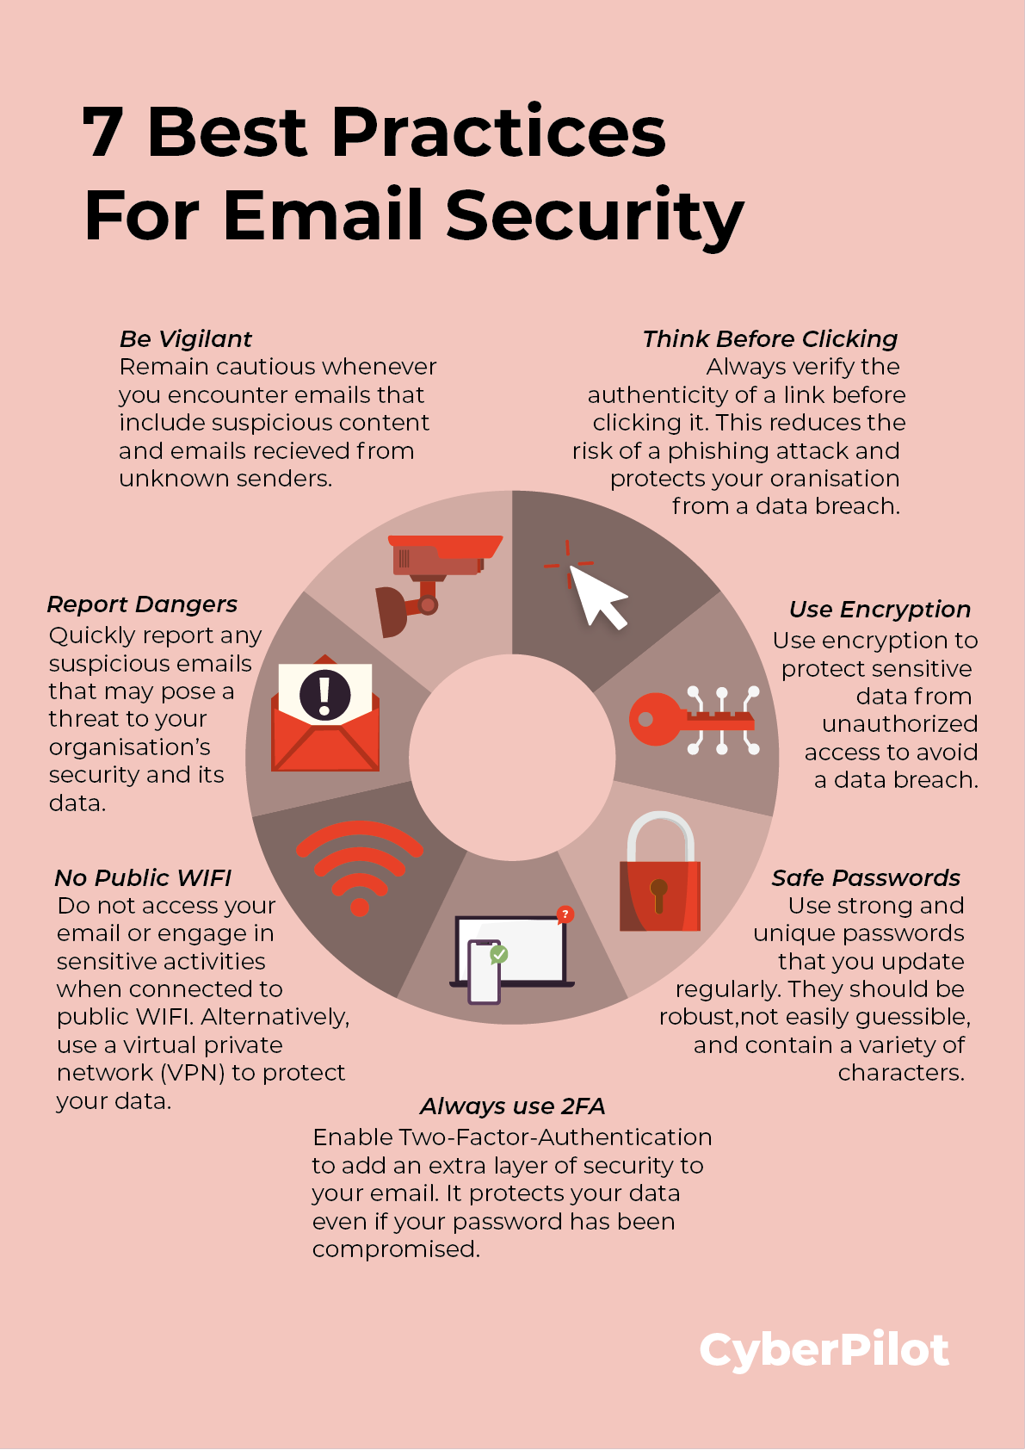
1️⃣ Do Not Click Suspicious Links
🔗 Explanation: Phishing links redirect users to fake websites that steal login credentials.
📌 Example: SMS: “Your parcel is delayed. Click here to track.” ➡️ Correct action: Open courier website manually instead of clicking the link.
2️⃣ Enable Two-Factor Authentication (2FA)
🔑 Explanation: 2FA adds an extra security layer even if your password is compromised.
📌 Example: Even if an attacker steals your email password, they cannot log in without OTP from your phone.
3️⃣ Keep Software and Antivirus Updated
🛠️ Explanation: Updates fix security vulnerabilities that attackers exploit.
📌 Example: Updated browser blocks fake phishing websites automatically.

Slide 16
7️⃣Real world phishing examples
📌 Example 1: Fake bank email asking to “verify account” → leads to fake login page → credentials stolen.
📌 Example 2: SMS: “Your parcel is pending. Click here to track” → malware installation.
📌 Example 3: Email pretending to be HR asking for salary details.
📌 Example 4: “Hello, I am calling from your bank’s fraud department. Share OTP immediately.”
📌 Example 5: “Your account is hacked. Act now or funds will be lost.”
📌 Example 6: “You have won ₹50,000. Click here to claim.”

Slide 17
📧 Brief Example of a Phishing Attack
Scenario: You receive an email that looks like it’s from your bank.
Email says:
“Your bank account will be blocked due to suspicious activity. Click the link below to verify your account immediately.”
What happens next:
1)You click the link
2)A fake bank website opens
3)You enter your username, password, and OTP
4)Attacker steals your details and accesses your account
Why this is phishing:
->Creates urgency
->Uses fear
->Fake link and website
->Asks for sensitive information
✅ Correct action: Do not click the link. Open the bank’s official website manually or contact customer care.

Slide 18
8️⃣Interactive Quiz (For Engagement)
🧠 Quiz 1:
You receive an email saying your bank account will be locked in 30 minutes. What should you do?
A) Click the link immediately B) Reply with details C) Ignore the email and contact bank via official website ✅ D) Forward to friends

Slide 19
🧠 Quiz 2:
Which URL looks suspicious?
A) https://www.amazon.in B) https://www.amaz0n-support.com ✅ C) https://www.google.com D) https://www.microsoft.com

Slide 20
🧠 Quiz 3:
Phishing mainly exploits:
A) Weak hardware B) Network cables C) Human psychology ✅ D) Firewalls

Slide 21
“To stay safe from phishing attacks, users should verify senders, avoid clicking suspicious links, never share OTPs or passwords, enable two-factor authentication, and remain calm during urgent messages. Awareness is the strongest defense.”
Thank you and stay safe online.

